Slide 1
Artificial Intelligence
Evaluation I

Slide 2
Overview
New material: doing better at evaluation (saying how well our classifier is performing)

Slide 3
Second term topics: details
Data exploration and preparation (1 week)
We need to add some of the basic bits we skipped last term
Evaluation (2 weeks)
Really important: we all need to know the important methods for establishing exactly how well our ML methods are performing
Feature extraction (2 weeks)
Really interesting topic: if our data doesn’t have a really obvious consistent structure (e.g., text documents, images) then how should we extract features
Support Vector Machines (2 weeks)
A final “black box” technique we think you should have some exposure to (e.g., visualising, tuning hyperparameters)
Then over to Deep Learning with Nick (3 weeks, not assessed)

Slide 4
Evaluation (so far…)
Confusion matrices
Overall accuracy score
This is a good measure…
…Particularly if there are lots of classes (big confusion matrix)
But can also be a “blunt” measure of performance, missing important details…
With better measures we can make better decisions (e.g., which classifier is best? What should the hyperparameters be? What can we reasonably expect in terms of future performance?)

Slide 5
Evaluation (doing better…)
There are better measures available, capturing more information
Especially for the case of binary classification (two classes)
Binary classifier are often what we’re dealing with in the most important automatic decision making processes

Slide 6
Evaluation (doing better…)
Examples of binary classification problems:
Is the patient a carrier or not
Is the Youtube video suitable for children or not
Is the customer in the CCTV a shoplifter or not
Is the object in the road a breaking hazard or not*
Is the market currently suited to selling these shares or not
Is the thumbprint the phone’s owner’s or not
Is the customer worth targeting in the upcoming ad campaign or not?
…
Often essential to get the best possible performance
* Further reading: link

Slide 7
A closer look at confusion matrices
Calculated them in the A-labs last term
Read about them in this week’s reading
Tried calculating them in the practice exam questions on Moodle (?)
Let’s have another look…
As last week, let’s have the Wisconsin biopsies dataset as our example
Classes are: ‘benign’ (no problem); ‘malignant’ (problem)
We train some classifier – the details of which don’t matter – how good is it?
Let’s imagine a really small testing dataset for ease: 10 from each class

Slide 8
Confusion matrices: reminder
Predicted class
Benign
Malignant
8 | 2
1 | 9
Benign
True class
Malignant

Slide 9
Confusion matrices: reminder
Predicted class
Must add up to the total number of Benign examples in the testing data
Benign
Malignant
8 | 2
1 | 9
= 10
Benign
True class
Malignant
= 10
Must add up to the total number of Malignant examples in the testing data

Slide 10
Confusion matrices: reminder
Predicted class
Benign
Malignant
8 | 2
1 | 9
= 10
Benign
True class
Malignant
= 10
If this goes up by 1…
This must go down by 1…

Slide 11
Confusion matrices: reminder
Predicted class
But the changes in the row below have no impact on this row
Benign
Malignant
8 | 2
1 | 9
= 10
Benign
True class
Malignant
= 10
If this goes up by 1…
This must go down by 1…

Slide 12
Confusion matrices: reminder
This is true, but in practice we are likely to find there is some relationship – more later…
Predicted class
But the changes in the row below have no impact on this row
Benign
Malignant
8 | 2
1 | 9
= 10
Benign
True class
Malignant
= 10
If this goes up by 1…
This must go down by 1…

Slide 13
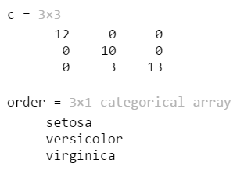
Confusion matrices: reminder
See for practice question: once you have some predictions, Matlab’s confusionmat() function can generate a confusion matrix for you (see also the A labs)
[c, order] = confusionmat(test_labels, predictions)
The matrix is stored in c
The labels of the rows (reading down) and columns (reading across) are stored in order

Slide 14
Confusion matrices: reminder
Predicted class
See for practice question: describing the matrix in words
“8 of the 10 Benign examples were correctly classified as Benign”
“2 of the 10 Benign examples were incorrectly classified as Malignant”
“1 of the 10 Malignant examples was incorrectly classified as Benign”
“9 of the 10 Malignant examples were correctly classified as Malignant”
Benign
Malignant
8 | 2
1 | 9
Benign
True class
Malignant

Slide 15
Confusion matrices: reminder
This matrix contains exactly the same information
Predicted class
See for practice question: describing the matrix in words
“8 of the 10 Benign examples were correctly classified as Benign”
“2 of the 10 Benign examples were incorrectly classified as Malignant”
“1 of the 10 Malignant examples was incorrectly classified as Benign”
“9 of the 10 Malignant examples were correctly classified as Malignant”
Malignant
Benign
9 | 1
2 | 8
Malignant
True class
Benign
Careful: there is no universal convention about the order of the row/column labels – Matlab uses alphabetical ordering

Slide 16
Confusion matrices: reminder
Predicted class
We’ll stick with the original in these slides
See for practice question: describing the matrix in words
“8 of the 10 Benign examples were correctly classified as Benign”
“2 of the 10 Benign examples were incorrectly classified as Malignant”
“1 of the 10 Malignant examples was incorrectly classified as Benign”
“9 of the 10 Malignant examples were correctly classified as Malignant”
Benign
Malignant
8 | 2
1 | 9
Benign
True class
Malignant
Careful: there is no universal convention about the order of the row/column labels – Matlab uses alphabetical ordering

Slide 17
Confusion matrices: reminder
Predicted class
So far we’ve calculated overall accuracy as…
Total no. of correctly classified examples / total no. of examples
See for practice question: sum(diag(c)) / sum(c(1:1:end))
Here:
(8 + 9) / (8 + 2 + 1 + 9)
( 17 ) / ( 20 )
0.85
OR… 85%
Benign
Malignant
8 | 2
1 | 9
Benign
True class
Malignant

Slide 18
Confusion matrices: reminder
Predicted class
So far we’ve calculated overall accuracy as…
Total no. of correctly classified examples / total no. of examples
See for practice question: sum(diag(c)) / sum(c(1:1:end))
Here:
(8 + 9) / (8 + 2 + 1 + 9)
( 17 ) / ( 20 )
0.85
OR… 85%
Benign
Malignant
8 | 2
1 | 9
Benign
True class
Malignant
Nice command because will work on a matrix of any size

Slide 19
Confusion matrices: reminder
Predicted class
So far we’ve calculated overall accuracy as…
Total no. of correctly classified examples / total no. of examples
See for practice question: sum(diag(c)) / sum(c(1:1:end))
Here:
(8 + 9) / (8 + 2 + 1 + 9)
( 17 ) / ( 20 )
0.85
OR… 85%
Benign
Malignant
8 | 2
1 | 9
Benign
True class
Malignant

Slide 20
Confusion matrices: reminder
Predicted class
So far we’ve calculated overall accuracy as…
Total no. of correctly classified examples / total no. of examples
See for practice question: sum(diag(c)) / sum(c(1:1:end))
Here:
(8 + 9) / (8 + 2 + 1 + 9)
( 17 ) / ( 20 )
0.85
OR… 85%
Benign
Malignant
8 | 2
1 | 9
Benign
True class
Malignant

Slide 21
Overall accuracy – limited usefulness
Useful example from the reading:
“Suppose that for 99,990 out of 100,000 newborn babies a classifier correctly predicted whether [or not] they were a carrier of a treatable but potentially fatal genetic defect” (Lantz, Chapter 10)

Slide 22
Overall accuracy – limited usefulness
Useful example from the reading:
“Suppose that for 99,990 out of 100,000 newborn babies a classifier correctly predicted whether [or not] they were a carrier of a treatable but potentially fatal genetic defect” (Lantz, Chapter 10)
Total no. of correctly classified examples / total no. of examples
Here:
99,990 / 100,000
0.9999
OR… 99.99%
At a glance: extremely accurate!

Slide 23
Overall accuracy – limited usefulness
Useful example from the reading:
“Suppose that for 99,990 out of 100,000 newborn babies a classifier correctly predicted whether [or not] they were a carrier of a treatable but potentially fatal genetic defect” (Lantz, Chapter 10)
“What if the genetic defect is found in only 10 out of every 100,000 babies? A test that predicts ‘no defect’ regardless of the circumstances will be correct for 99.99% of all cases, but incorrect for 100% of the cases that matter most” (Lantz, Chapter 10)

Slide 24
Overall accuracy – limited usefulness
Predicted class
Total no. of correctly classified examples / total no. of examples
Here:
(990,000 + 0) / (990,000 + 0 + 10 + 0)
( 990,000 ) / ( 100,000 )
0.9999
OR… 99.99%
No defect
Defect
990,000 | 0
10 | 0
No defect
True class
Defect

Slide 25
More useful measures
Conclusion: We need better measures…
Something more compact than the full confusion matrix
But that retains enough information that we can meaningfully evaluate/tune/compare performance

Slide 26
More useful measures
There are lots of measures you can compute from the confusion matrix
Different measures are popular in different fields/problems/companies…
Even worse… There is generally more than 1 name for the same measure*
It can get very confusing very quickly [did you peek ahead in Chapter 10?]
Aim here today: look at the simplest versions of the most important ideas, and keep the naming convention simple and consistent
In future: you will have enough knowledge to switch to other measures (and other naming conventions) if/when required
* Have a look at the Wikipedia page for confusion matrices if you’re interested (blue sidebar): https://en.wikipedia.org/wiki/Confusion_matrix

Slide 27
New terminology
Need language to help us think of all those different possible binary classification problems in the same way:
‘Carrier’, ‘suitable for children’, ‘shoplifter’, ‘breaking hazard’, ‘selling environment’, ‘owner’, ‘campaign target’, …
From the reading [Chapter 10, Lantz]:
“The class of interest is known as the positive class, while all others are known as negative”
“The use of the terms positive and negative is not intended to imply any value judgment (that is, good versus bad)”…
…It is just an outcome that you are particularly interested in

Slide 28
Positive class: examples
Predicted class
Here’s our original matrix again…
We’re really interested in the cases where there is a problem: ‘Malignant’
Let’s make that our positive class…
Benign
Malignant
8 | 2
1 | 9
Benign
True class
Malignant

Slide 29
Positive class: examples
Predicted class
Here’s our original matrix again…
We’re really interested in the cases where there is a problem: ‘Malignant’
Let’s make that our positive class…
Negative
Positive
8 | 2
1 | 9
Negative
True class
Positive

Slide 30
More terminology
Predicted class
New naming convention:
TN: True Negatives (classified negative and they really were)
FP: False Positives (classified positive, but they weren’t)
FN: False Negatives (classified negative, but they weren’t)
TP: True Positives (classified positive and they really were)
Negative
Positive
TN | FP
FN | TP
Negative
True class
Positive

Slide 31
More terminology
Predicted class
New naming convention:
TN: True Negatives (classified negative and they really were)
FP: False Positives (classified positive, but they weren’t)
FN: False Negatives (classified negative, but they weren’t)
TP: True Positives (classified positive and they really were)
Negative
Positive
TN | FP
FN | TP
Negative
True class
Positive
Careful: the positions of these values can change (depending on the ordering of a confusion matrix and choice of positive class)

Slide 32
New terminology
Now we have new and general terminology…
…enabling us to talk about any binary classification problem we’re interested in…
…let’s look at using it to define some better evaluation measures

Slide 33
New idea 1
Predicted class
Motivated by the classifier that always predicted ‘no defect’…
We need a way to measure the proportion of positive examples that are correctly classified
Negative
Positive
TN | FP
FN | TP
Negative
True class
Positive

Slide 34
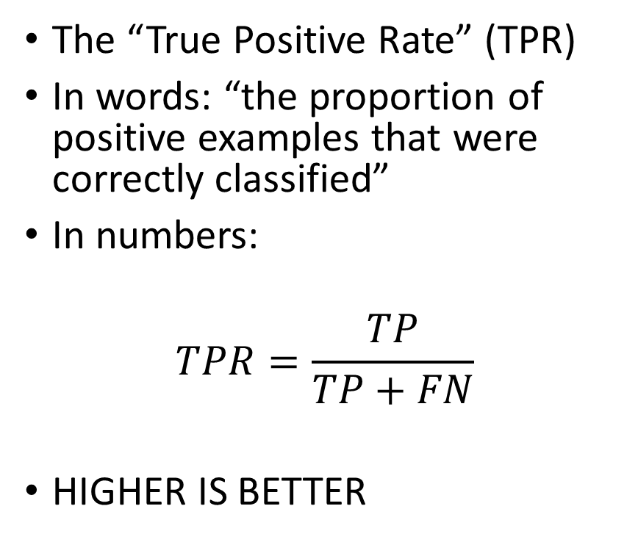
New measure 1: True Positive Rate (TPR)
Predicted class
The “True Positive Rate” (TPR)
In words: “the proportion of positive examples that were correctly classified”
In numbers:
$$TPR=\frac{TP}{TP+FN}$$
HIGHER IS BETTER
Negative
Positive
TN | FP
FN | TP
Negative
True class
Positive

Slide 35
Example 1: True Positive Rate (TPR)
Predicted class
Let’s calculate the TPR for the classifier that always predicted ‘no defect’…
See what it reveals…
No defect
Defect
990,000 | 0
10 | 0
No defect
True class
Defect

Slide 36
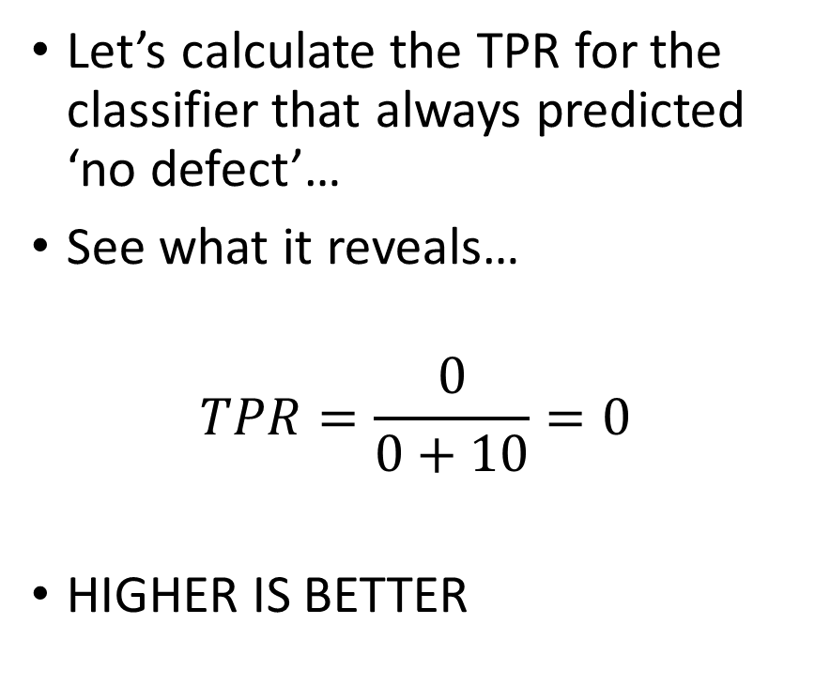
Example 1: True Positive Rate (TPR)
Predicted class
Let’s calculate the TPR for the classifier that always predicted ‘no defect’…
See what it reveals…
$$TPR=\frac{0}{0+10}=0$$
HIGHER IS BETTER
Negative
Positive
990,000 | 0
10 | 0
Negative
True class
Positive

Slide 37
Example 1: True Positive Rate (TPR)
Predicted class
Let’s calculate the TPR for the classifier that always predicted ‘no defect’…
See what it reveals…
$$TPR=\frac{0}{0+10}=0$$
HIGHER IS BETTER
Negative
Positive
990,000 | 0
10 | 0
Negative
True class
Positive
Bad score!

Slide 38
Example 1: True Positive Rate (TPR)
The example shows that the TPR reveals the weakness of the classifier
Although its overall accuracy is very high…
…It can’t identify defects
And this fact is revealed by the low (zero) TPR
Question: is TPR alone a good enough measure to work with?

Slide 39
Example 2: True Positive Rate (TPR)
Predicted class
To answer this, let’s consider the other extreme…
A classifier that always predicts ‘defect’
(This classifier is equally useless, but in a different way…)
No defect
Defect
0 | 990,000
0 | 10
No defect
True class
Defect

Slide 40
Example 2: True Positive Rate (TPR)
Predicted class
To answer this, let’s consider the other extreme…
A classifier that always predicts ‘defect’
(This classifier is equally useless, but in a different way…)
Negative
Positive
0 | 990,000
0 | 10
Negative
True class
Positive

Slide 41
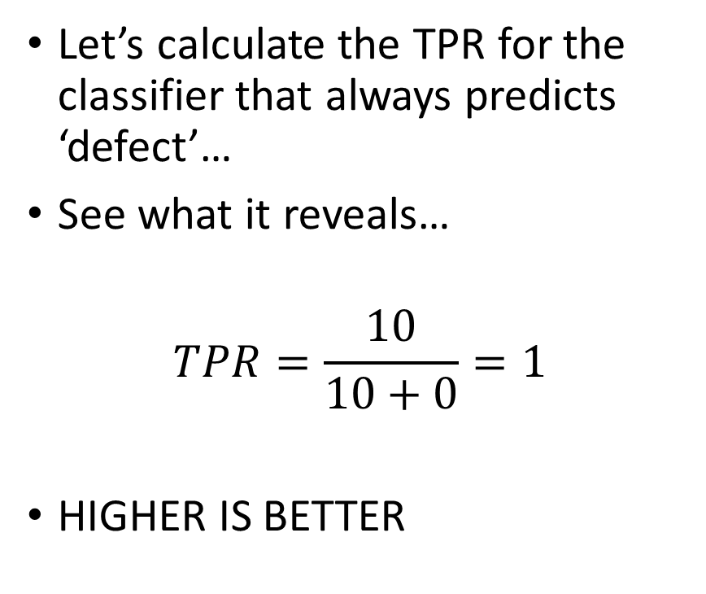
Example 2: True Positive Rate (TPR)
Predicted class
Let’s calculate the TPR for the classifier that always predicts ‘defect’…
See what it reveals…
$$TPR=\frac{10}{10+0}=1$$
HIGHER IS BETTER
Negative
Positive
0 | 990,000
0 | 10
Negative
True class
Positive

Slide 42
Example 2: True Positive Rate (TPR)
Predicted class
Let’s calculate the TPR for the classifier that always predicts ‘defect’…
See what it reveals…
$$TPR=\frac{10}{10+0}=1$$
HIGHER IS BETTER
Negative
Positive
0 | 990,000
0 | 10
Negative
True class
Positive
Good score!

Slide 43
Example 2: True Positive Rate (TPR)
The example shows that the TPR doesn’t reveal the weakness of the classifier
Although its TPR is very high (one)…
…It is claiming that everyone has the defect
Conclusion: we need more information (than just TPR) when thinking about performance

Slide 44
New idea 2
Predicted class
Motivated by the classifier that always predicted ‘defect’…
We ALSO need a way to measure the proportion of negative examples that are incorrectly classified as positive
Negative
Positive
TN | FP
FN | TP
Negative
True class
Positive

Slide 45
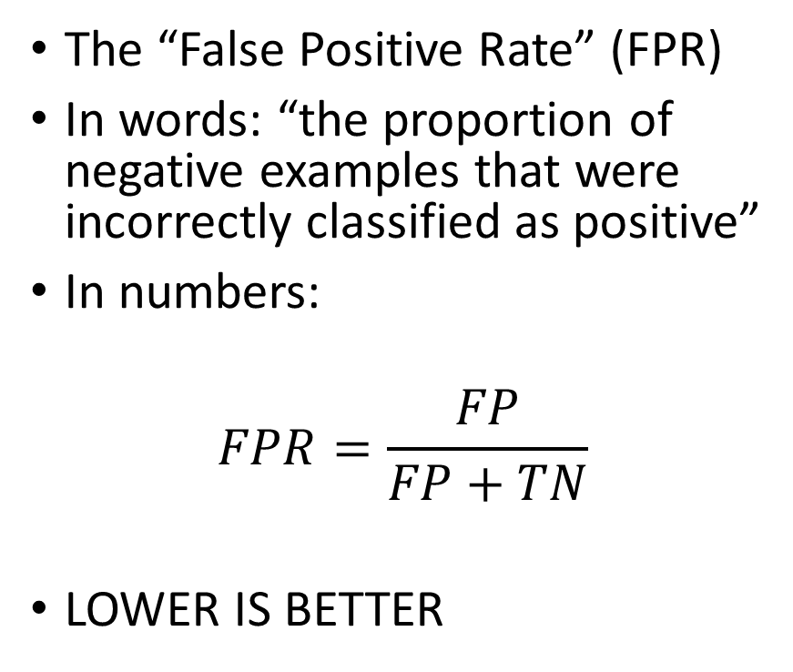
New measure 2: False Positive Rate (FPR)
Predicted class
The “False Positive Rate” (FPR)
In words: “the proportion of negative examples that were incorrectly classified as positive”
In numbers:
$$FPR=\frac{FP}{FP+TN}$$
LOWER IS BETTER
Negative
Positive
TN | FP
FN | TP
Negative
True class
Positive

Slide 46
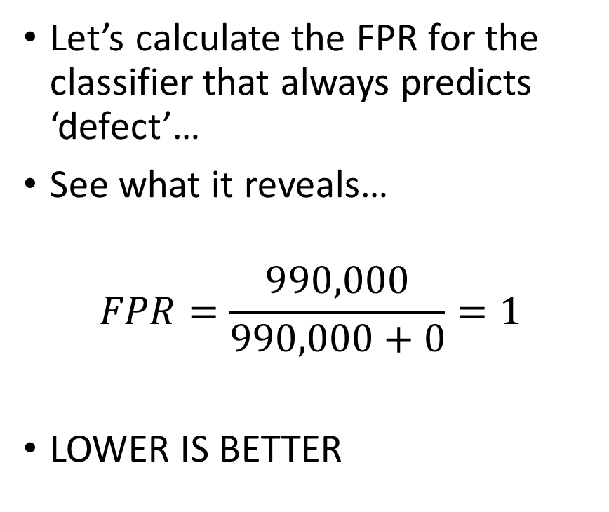
Example 3: False Positive Rate (FPR)
Predicted class
Let’s calculate the FPR for the classifier that always predicts ‘defect’…
See what it reveals…
$$FPR=\frac{990,000}{990,000+0}=1$$
LOWER IS BETTER
Negative
Positive
0 | 990,000
0 | 10
Negative
True class
Positive

Slide 47
Example 3: False Positive Rate (FPR)
Predicted class
Let’s calculate the FPR for the classifier that always predicts ‘defect’…
See what it reveals…
$$FPR=\frac{990,000}{990,000+0}=1$$
LOWER IS BETTER
Negative
Positive
0 | 990,000
0 | 10
Negative
True class
Positive
Bad score!

Slide 48
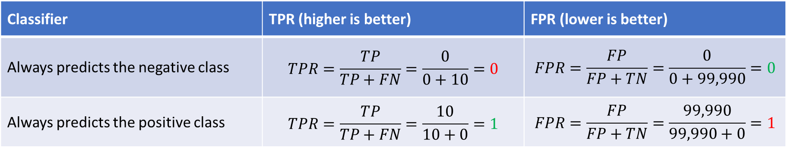
Example 3: False Positive Rate (FPR)
The example shows that considering both the TPR and the FPR together can give us a good picture of overall performance
The table below summarises the measures for both the classifiers
Bad score!
Classifier | TPR (higher is better) | FPR (lower is better)
Always predicts the negative class | $$TPR=\frac{TP}{TP+FN}=\frac{0}{0+10}=0$$ | $$FPR=\frac{FP}{FP+TN}=\frac{0}{0+99,990}=0$$
Always predicts the positive class | $$TPR=\frac{TP}{TP+FN}=\frac{10}{10+0}=1$$ | $$FPR=\frac{FP}{FP+TN}=\frac{99,990}{99,990+0}=1$$
Bad score!

Slide 49
TPR versus FPR
Rather than using a table, let’s plot the classifiers on a graph…
1
True Positive Rate (TPR)
(higher is better)
0
0
False Positive Rate (FPR)
(lower is better)
1

Slide 50
TPR versus FPR
1
True Positive Rate (TPR)
(higher is better)
Always predicting the negative class
0
0
False Positive Rate (FPR)
(lower is better)
1

Slide 51
TPR versus FPR
1
Always predicting the positive class
True Positive Rate (TPR)
(higher is better)
Always predicting the negative class
0
0
False Positive Rate (FPR)
(lower is better)
1

Slide 52
TPR versus FPR
This is where we really want to be…
1
Always predicting the positive class
True Positive Rate (TPR)
(higher is better)
Always predicting the negative class
0
0
False Positive Rate (FPR)
(lower is better)
1

Slide 53
TPR versus FPR
This is where we really want to be…
1
Always predicting the positive class
True Positive Rate (TPR)
(higher is better)
Always predicting the negative class
0
We’ll come back to this kind of visualisation…
0
False Positive Rate (FPR)
(lower is better)
1

Slide 54
Exam preparation: step 1
See for practice question: Everyone must be comfortable calculating the TPR and the FPR from a given confusion matrix (see the equations)
Common mistake: muddling up the positive and negative class
EITHER: you decide which is the positive class and clearly state it in your answer
OR: you are told which is the positive class in the question
You can then think of the entries in the matrix in terms of TP, FN, TN, FP and do the two calculations
You can get any entry in a confusion matrix c using normal braces, e.g. c(2,2) gives you the value 2 rows down, 2 columns across
You’ll need to use some brackets to ensure the addition happens before the division…

Slide 55
Going further…
Needed for harder exam questions on the topic of evaluation
If you’re definitely interested, then, once you’re comfortable with TPR and FPR… (Suggest re-reading these slides and double checking last week’s reading)
…It’s worth reading Lantz, Chapter 10: section entitled “ROC curves”
[This isn’t the reading for next week – that’s coming later]

Slide 56
Going further…
Recap: We’re interested in measures that will help us understand how well our classifier is performing
Is it performing better/worse than other classifiers?
Can we take steps to improve its performance?
Is it likely to perform well in future?
Next steps depend on understanding how the classifier gives its answer…

Slide 57
Generating a prediction
When any of the classifiers we’ve studied make a prediction they rarely do it with complete certainty:
E.g., “the example is definitely malignant”
They consider the likelihood that the example belongs to each class:
E.g., “the example is malignant with a likelihood of 70%…
…And benign with a likelihood of 30%”
If all you’re interested in is the predicted class – you’ll just see ‘malignant’…
…But if you’re interested in the confidence the classifier has in its predictions, you can ask to see the classification scores for each class

Slide 58
Generating a prediction
Classification scores – numbers between 0-1 indicating the likelihood that the example belongs to each class
E.g.:
[0.6 0.4] – 60% likelihood the example belonged to the negative class; 40% likelihood it belonged to the positive class
[0.22 0.78] – 22% likelihood the example belonged to the negative class; 78% likelihood it belonged to the positive class
See for practice question: you can get classification scores back from any of the fitc*() functions by specifying a second return argument: [predictions, scores] = predict(m, test_examples);
Is a matrix of scores with one row for each test example, and the column labels given by m.ClassNames

Slide 59
Generating a prediction
We’ll also have some questions on converting the my*() classes to additionally return classification scores
See for practice questions: where do the scores come from?
KNN – the proportion of the nearest neighbours belonging to each class
NB – calculating the full posterior (not just the value that is proportional to it)
DTs – the proportion of examples in the leaf node belonging to each class

Slide 60
Generating a prediction
“It is possible that two classifiers with similar accuracy [and TPR/FPR] could have drastic differences in how they achieve their accuracy.”
“Some models may struggle with certain predictions that others make with ease, while breezing through the cases that others cannot get right” [Lantz, Chapter 10]
E.g.:
NB: Classification scores: [0.49 0.51]; prediction: positive; true class: positive
Classifier was correct but with low confidence
K-NN: Classification scores: [0.1 0.9]; prediction: positive ; true class: positive
Classifier was correct with high confidence
DT: Classification scores: [0.99 0.01]; prediction: negative; true class: positive
Classifier was incorrect and with high confidence

Slide 61
Implications
There are two implications of additionally considering the likelihoods
First, when trying to measure how well a classifier is performing: it would be good if we could take these confidence levels into account
Second, for a particular trained classifier: should we consider changing the threshold on confidence levels?
By default, any binary classifier you train will predict the positive class if and only if the classification score was >0.5
But what happens to overall performance if you increase that threshold?
Or decrease it?
Receiver Operating Characteristic (ROC) curves can help you do both these things

Slide 62
Receiver Operating Characteristic (ROC) curves
ROC curves are a visualisation (a graph) rather than a single measure
They show you how the TPR and FPR rate change as the threshold for predicting the positive class is changed
Imagine yourself with a dial you can turn to gradually lower the likelihood threshold for the positive class (from 100%+ down to 0%)…
An ROC curve plots the effect that you turning the dial has on the TPR and FPR

Slide 63
ROC curves
1
Imagine a dial you can twist to gradually decrease the likelihood threshold for the positive class:
100%+ confidence required… [always predicting the negative class]
100% confidence required…
99% confidence required…
…
1% confidence required…
0% confidence required [always predicting the positive class]
True Positive Rate (TPR)
(higher is better)
0
0
False Positive Rate (FPR)
(lower is better)
1

Slide 64
ROC curves
1
Imagine a dial you can twist to gradually decrease the likelihood threshold for the positive class:
100%+ confidence required… [always predicting the negative class]
100% confidence required…
99% confidence required…
…
1% confidence required…
0% confidence required [always predicting the positive class]
True Positive Rate (TPR)
(higher is better)
Always predicting the negative class
0
0
False Positive Rate (FPR)
(lower is better)
1

Slide 65
ROC curves
1
Imagine a dial you can twist to gradually decrease the likelihood threshold for the positive class:
100%+ confidence required… [always predicting the negative class]
100% confidence required…
99% confidence required…
…
1% confidence required…
0% confidence required [always predicting the positive class]
Always predicting the positive class
True Positive Rate (TPR)
(higher is better)
Always predicting the negative class
0
0
False Positive Rate (FPR)
(lower is better)
1

Slide 66
ROC curves
1
Imagine a dial you can twist to gradually decrease the likelihood threshold for the positive class:
100%+ confidence required… [always predicting the negative class]
100% confidence required…
99% confidence required…
…
1% confidence required…
0% confidence required [always predicting the positive class]
Always predicting the positive class
True Positive Rate (TPR)
(higher is better)
Always predicting the negative class
0
0
False Positive Rate (FPR)
(lower is better)
1

Slide 67
ROC curves
1
Imagine a dial you can twist to gradually decrease the likelihood threshold for the positive class:
100%+ confidence required… [always predicting the negative class]
100% confidence required…
99% confidence required…
…
1% confidence required…
0% confidence required [always predicting the positive class]
Always predicting the positive class
True Positive Rate (TPR)
(higher is better)
Always predicting the negative class
0
0
False Positive Rate (FPR)
(lower is better)
1

Slide 68
ROC curves
1
Imagine a dial you can twist to gradually decrease the likelihood threshold for the positive class:
100%+ confidence required… [always predicting the negative class]
100% confidence required…
99% confidence required…
…
1% confidence required…
0% confidence required [always predicting the positive class]
Always predicting the positive class
True Positive Rate (TPR)
(higher is better)
Always predicting the negative class
0
0
False Positive Rate (FPR)
(lower is better)
1

Slide 69
TPR/FPR tradeoff
We talked about the rows in the confusion matrix being independent
True in the sense that they don’t have to add up to any particular value…
…But in fact, for a typical classifier, the TPR and FPR are related:
You can reduce the threshold to increase the TPR (good)…
…But you will simultaneously increase the FPR (bad)
And:
You can increase the threshold to decrease the FPR (good)…
…But you will simultaneously decrease the TPR (bad)

Slide 70
TPR/FPR tradeoff: in words
For a typical classifier, the TPR and FPR are related:
You can reduce the threshold to increase the TPR (good)…
…But you will simultaneously increase the FPR (bad)
And:
You can increase the threshold to decrease the FPR (good)…
…But you will simultaneously decrease the TPR (bad)
“By ensuring I identify more of the positive examples, I also mis-classify more negative examples as positive”

Slide 71
TPR/FPR tradeoff: in words
For a typical classifier, the TPR and FPR are related:
You can reduce the threshold to increase the TPR (good)…
…But you will simultaneously increase the FPR (bad)
And:
You can increase the threshold to decrease the FPR (good)…
…But you will simultaneously decrease the TPR (bad)
“By ensuring I identify more of the positive examples, I also mis-classify more negative examples as positive”
“By ensuring I mis-classify fewer of the negative examples as positive, I also fail to identify more positive examples”

Slide 72
TPR/FPR tradeoff: in pictures
Positive
Negative
Feature 2
Feature 1

Slide 73
TPR/FPR tradeoff: in pictures
Positive
Negative
Feature 2
“By ensuring I identify more of the positive examples, I also mis-classify more negative examples as positive”
Feature 1

Slide 74
TPR/FPR tradeoff: in pictures
Positive
Negative
Feature 2
Feature 1

Slide 75
TPR/FPR tradeoff: in pictures
Positive
Negative
Feature 2
“By ensuring I mis-classify fewer of the negative examples as positive, I also fail to identify more positive examples”
Feature 1

Slide 76
TPR/FPR tradeoff
If the extra words/pictures don’t help then don’t worry…
…It’s sufficient just to remember the basic tradeoff:
For a typical classifier, the TPR and FPR are related:
You can reduce the threshold to increase the TPR (good)…
…But you will simultaneously increase the FPR (bad)
And:
You can increase the threshold to decrease the FPR (good)…
…But you will simultaneously decrease the TPR (bad)

Slide 77
ROC curves
Optional: Have a look at the “ROC curve algorithm slides”

Slide 78
ROC curves
1
This is the ROC curve you hope for: A “perfect classifier”
As we lower the threshold there comes a stage where we get to:
TPR=1 while…
…We still have FPR=0
The point up in the top left
This means there is a threshold* we could choose that would give perfect results on the testing data
Always predicting the positive class
True Positive Rate (TPR)
(higher is better)
Always predicting the negative class
0
0
False Positive Rate (FPR)
(lower is better)
1
* (Note the ROC curve doesn’t show you what it is)

Slide 79
ROC curves
1
A “bad classifier” with no predictive value (that gives essentially random predictions) will meander diagonally between the points
Always predicting the positive class
True Positive Rate (TPR)
(higher is better)
Always predicting the negative class
0
0
False Positive Rate (FPR)
(lower is better)
1

Slide 80
ROC curves
1
A “bad classifier” with no predictive value (that gives essentially random predictions) will meander diagonally between the points
Always predicting the positive class
True Positive Rate (TPR)
(higher is better)
Always predicting the negative class
0
0
False Positive Rate (FPR)
(lower is better)
1

Slide 81
ROC curves
1
A “bad classifier” with no predictive value (that gives essentially random predictions) will meander diagonally between the points
Always predicting the positive class
True Positive Rate (TPR)
(higher is better)
Always predicting the negative class
0
0
False Positive Rate (FPR)
(lower is better)
1

Slide 82
ROC curves
1
A “bad classifier” with no predictive value (that gives essentially random predictions) will meander diagonally between the points
On average, bad classifiers will trace out the dashed diagonal line
Always predicting the positive class
True Positive Rate (TPR)
(higher is better)
Always predicting the negative class
0
0
False Positive Rate (FPR)
(lower is better)
1

Slide 83
ROC curves
1
For a real classifier that you are working with…
The closer its ROC curve runs to that of the “perfect classifier”, the better it is at identifying positive examples
The area under the ROC curve (AUC) provides a good measure of a classifier’s performance
Always predicting the positive class
True Positive Rate (TPR)
(higher is better)
Always predicting the negative class
0
0
False Positive Rate (FPR)
(lower is better)
1

Slide 84
ROC curves
1
For a real classifier that you are working with…
The closer its ROC curve runs to that of the “perfect classifier”, the better it is at identifying positive examples
The area under the ROC curve (AUC) provides a good measure of a classifier’s performance
better
worse
Always predicting the positive class
True Positive Rate (TPR)
(higher is better)
Always predicting the negative class
0
0
False Positive Rate (FPR)
(lower is better)
1

Slide 85
ROC curves
1
For a real classifier that you are working with…
The closer its ROC curve runs to that of the “perfect classifier”, the better it is at identifying positive examples
The area under the ROC curve (AUC) provides a good measure of a classifier’s performance
HIGHER IS BETTER
Always predicting the positive class
True Positive Rate (TPR)
(higher is better)
Always predicting the negative class
0
0
False Positive Rate (FPR)
(lower is better)
1

Slide 86
ROC curves in Matlab
1
See for practice question: Once you’ve trained a classifier, Matlab’s perfcurve() function can calculate the coordinates in the ROC curve for you
[x,y] = perfcurve(test_labels, scores_pos, string_pos);
scores_pos are the classification scores for the positive class only
string_pos is the positive class label
Always predicting the positive class
True Positive Rate (TPR)
(higher is better)
Always predicting the negative class
0
0
False Positive Rate (FPR)
(lower is better)
1

Slide 87
ROC curves in Matlab
1
See for practice question: Matlab’s perfcurve() function can also calculate the AUC
Task for you: have a look at the documentation
[Not needed for the exam, but if you’re interested: you can also find the optimal threshold value via T and OPTROCPT]
Always predicting the positive class
True Positive Rate (TPR)
(higher is better)
Always predicting the negative class
0
0
False Positive Rate (FPR)
(lower is better)
1

Slide 88
Next steps…
Try the practice exam questions
The first one just requires confusion matrix calculation/understanding and computing the TPR/FPR
The second one requires plotting/interpretting ROC curves
Use the red suggestions in the previous slides to help guide you
Don’t give up too easily…
Is supposed to require a little research/playing around/testing things out
Helps build stronger memories

Slide 89
1EXAM50: golden rule
If you do all the practice questions…
(And understand what you’re doing – i.e., don’t just copy the answers from someone else)
Then there’s no reason why you can’t get 100% on the exam

Slide 90
Reading for next week
Brett Lantz, “Machine Learning with R”
Chapter 10: “Evaluating Model Performance”
From the section entitled: “Estimating future performance”
Up to and including the section entitled: “Cross-validation”
Suggested approach (but do whatever works best for you):
Just relax and read through
As ever, we’re interested in the ideas, not the use of R
You’ve already met and used the “holdout” method
The “cross-validation” method is new and we’ll talk about it more next week

